Slide 1
CS 31006: Computer Networks

Slide 2
Objectives of the Course
Understand how two computers in the Internet talk to each other
Go through the basic functionalities of the computer networks
Learn how to program the network
Learn the future of the computer network – Do we need any further changes in the design?
Functionalities
Protocols
Network Architecture

Slide 3
So, What is Network Architecture?
A way to visualize how two remote computers talk to each other
Network Protocol Stack

Slide 4
So, What is Network Architecture?

Slide 5
So, What is Network Architecture?
Requirement: Convert digital data to analog signal and vice versa
Physical

Slide 6
So, What is Network Architecture?

Slide 7
So, What is Network Architecture?
L2 Switch
Data Link
Requirement: Ensure proper scheduling in media access
Physical

Slide 8
So, What is Network Architecture?

Slide 9
So, What is Network Architecture?
L3 Switch or Routers
Network
Data Link
Physical
Requirement: Find out a suitable path to forward data

Slide 10
So, What is Network Architecture?

Slide 11
So, What is Network Architecture?
Transport
Network
Data Link
Physical
Requirement: End to end traffic control in the network

Slide 12
So, What is Network Architecture?
Application
Transport
Network Protocol Stack
Network
Data Link
Physical

Slide 13
Data Transfer between Two Remote Machines
Source
Destination

Slide 14
Data Transfer between Two Remote Machines
Application
Application
Transport
Transport
Network
Network
Network
Data Link
Data Link
Data Link
Data Link
Data Link
Physical
Physical
Physical
Physical
Physical

Slide 15
Protocols at Different Layers
Application
HTTP, FTP, SMTP
Transport
TCP, UDP, RTP
Network
IPv4, IPv6, MPLS
Data Link
Ethernet, WiFi, Bluetooth, UMTS, LTE
Physical

Slide 16
Network Management and Control – Cross Layer Protocols
Application
HTTP, FTP, SMTP
DNS
Transport
TCP, UDP, RTP
SNMP
Network
IPv4, IPv6, MPLS
ARP, DHCP
Data Link
Ethernet, WiFi, Bluetooth, UMTS, LTE
Physical

Slide 17
Two Ways to Learn Computer Networks
Application
Application
Transport
Transport
Network
Network
Data Link
Data Link
Physical
Physical

Slide 18
Books to Follow …
Application
Transport
Network
Data Link
Physical

Slide 19
Books to Follow …
Application
Transport
Network
Data Link
Physical

Slide 20
Books to Follow (Online Books)…
Application
Transport
Network
Data Link
Physical
http://www.redbooks.ibm.com/abstracts/gg243376.html
http://www.tcpipguide.com/

Slide 21
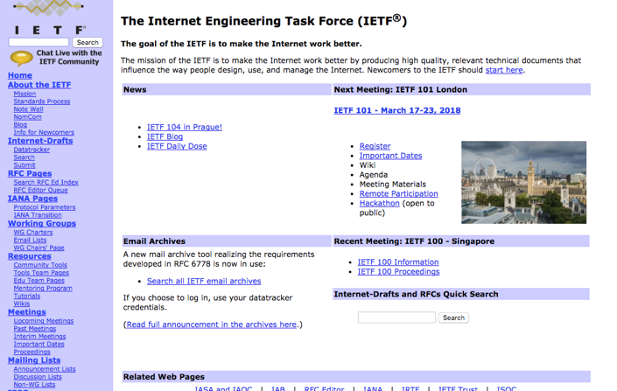
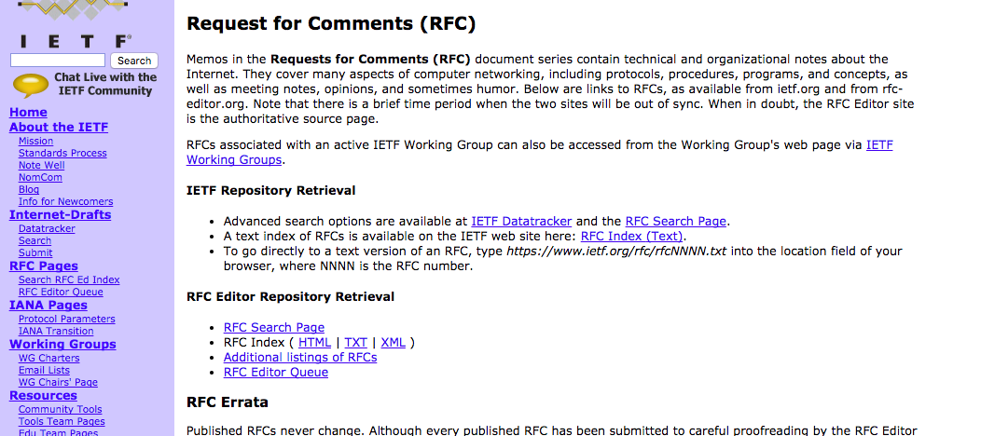
Internet Resources

Slide 22
Course Evaluations
Two class tests
Average: 20%
Mid semester Examination: 30%
End-semester Examination: 50%

Slide 23
Sections
Section - 1
Odd roll numbers
Class Room: NC 241
Primary Teacher: Prof. Rajat Subhra Chakraborty
Section - 2
Even roll numbers
Class Room: NC 242
Primary Teacher: Prof. Sandip Chakraborty

Slide 24
Other Course Related Information
Course Website: https://cse.iitkgp.ac.in/~sandipc/Courses/CS_31006_Spring_2020.html
All course materials will be posted in the website
We’ll set up a Piazza group – please use the group for any discussions
Attendance: Institute policy will be followed – deregistration for low attendance
Make the class live – no question is a stupid question !!!

